Slide 1
토픽 모델링 결과 정리

Slide 2
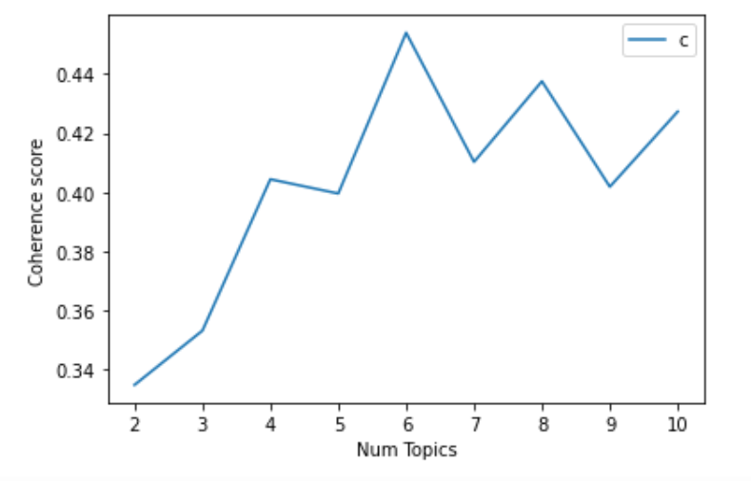
그래프 (제페토)

Slide 3
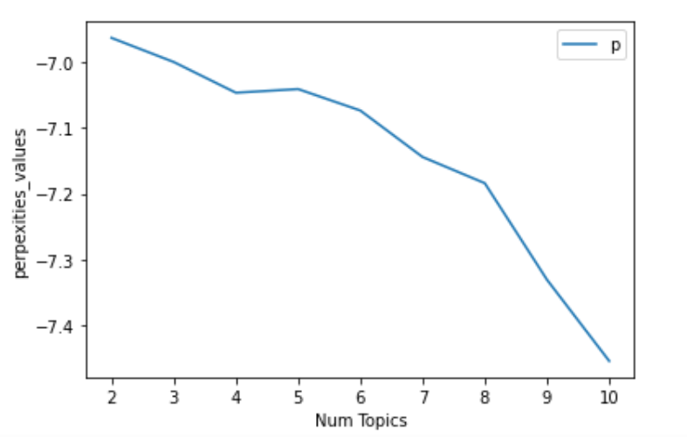
그래프 (제페토)

Slide 4
제페토 결과 값
2 coherence_value: 0.3347947886570322
2 perpexities_values: -6.964194384623799
3 coherence_value: 0.35316786370088593
3 perpexities_values: -7.0006590801787825
4 coherence_value: 0.40441204032694145
4 perpexities_values: -7.047232414489
5 coherence_value: 0.3995707020171052
5 perpexities_values: -7.0416951922144175
6 coherence_value: 0.4540097678303036
6 perpexities_values: -7.074162167450086
7 coherence_value: 0.4102800439716206
7 perpexities_values: -7.144497279869447
8 coherence_value: 0.43758780564788013
8 perpexities_values: -7.184154433275402
9 coherence_value: 0.4018681181966087
9 perpexities_values: -7.3303195541961275
10 coherence_value: 0.4273292291870284
10 perpexities_values: -7.4533577664159285

Slide 5
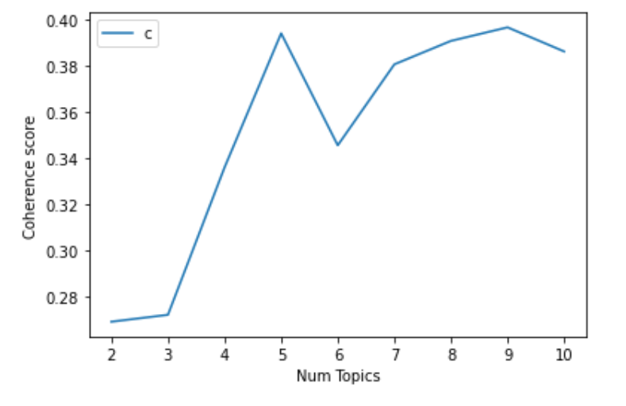
그래프 (로블록스)

Slide 6
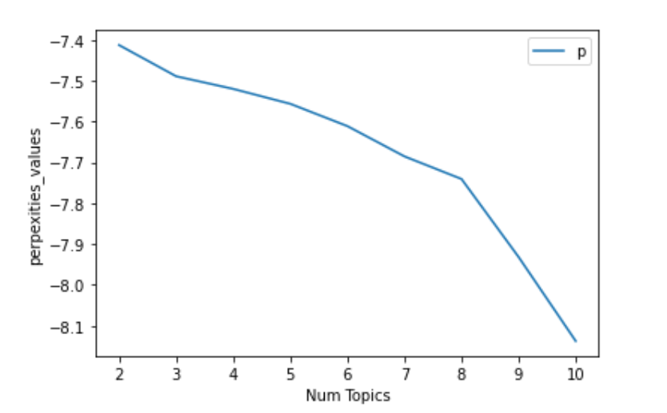
그래프 (로블록스)

Slide 7
로블록스 결과 값
2 coherence_value: 0.2690563506054858
2 perpexities_values: -7.412468089631719
3 coherence_value: 0.27204867100021746
3 perpexities_values: -7.488859174001777
4 coherence_value: 0.33589636192779493
4 perpexities_values: -7.5198072894656045
5 coherence_value: 0.393973681101621
5 perpexities_values: -7.556370269521297
6 coherence_value: 0.34546069733288065
6 perpexities_values: -7.610968217230962
7 coherence_value: 0.3805385295017749
7 perpexities_values: -7.685177881085269
8 coherence_value: 0.3906925668766468
8 perpexities_values: -7.7405882092654945
9 coherence_value: 0.39656206526118115
9 perpexities_values: -7.931725680895033
10 coherence_value: 0.3861225177504283
10 perpexities_values: -8.137491097092648

